Slide 1
Business Model
Sheryl Satorre-Estella, PhD.

Slide 2
Business Model
A business model describes the rationale of how an organization creates, delivers, and captures value, in economic, social, cultural or other contexts.
The Business Model Canvas, is a strategic management and entrepreneurial tool.
It allows you to describe, design, challenge, invent, and pivot your business model.

Slide 3
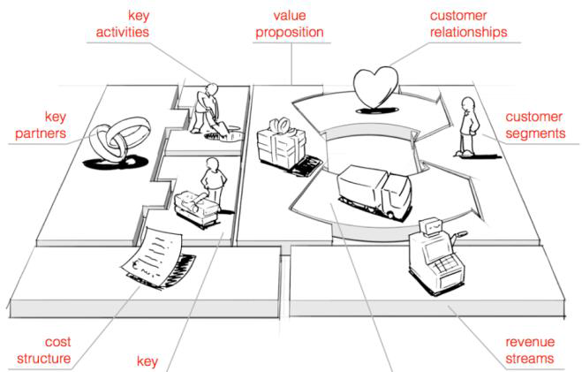
Business Model Canvas

Slide 4
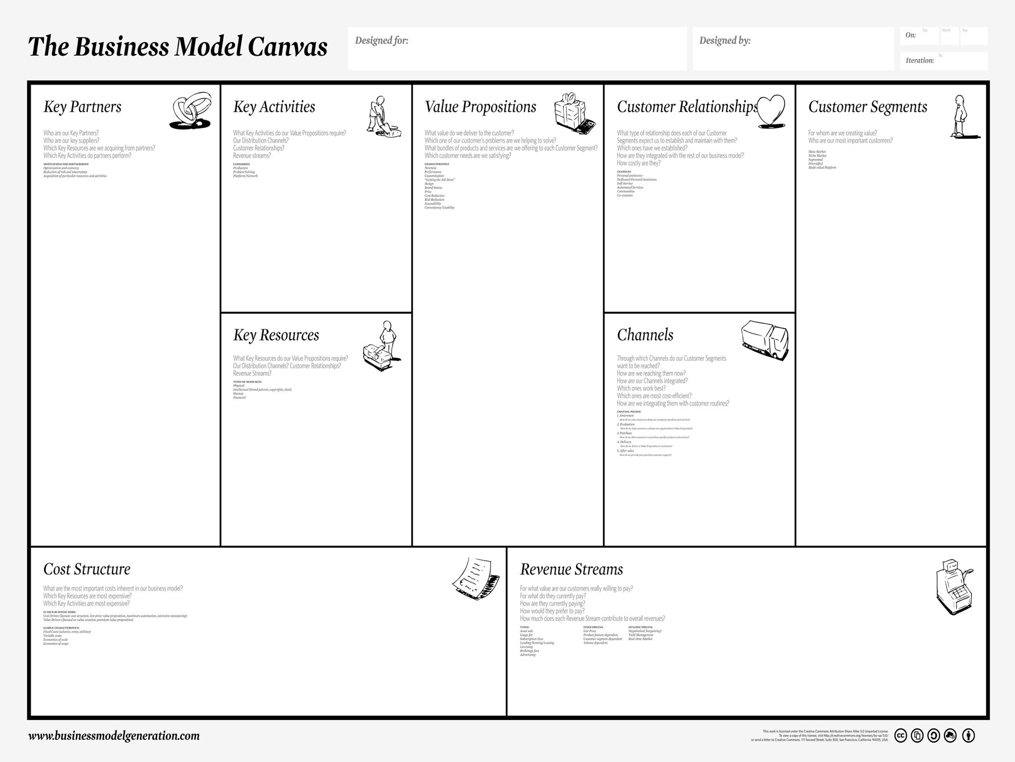
7
4
1
8
2
3
6
5
9

Slide 5
1. Customer Segments
For whom are we creating value?
Who are our most important customers?
Mass Market
Niche Market
Segmented
Diversified
Multi-sided Platform

Slide 6
Customer Segments
Mass Market: There is no specific segmentation for a company that follows the Mass Market element as the organization displays a wide view of potential clients. e.g. Car
Niche Market: Customer segmentation based on specialized needs and characteristics of its clients. e.g Rolex
Segmented: A company applies additional segmentation within existing customer segment. In the segmented situation, the business may further distinguish its clients based on gender, age, and/or income.

Slide 7
Customer Segments
Diversify: A business serves multiple customer segments with different needs and characteristics.
Multi-Sided Platform / Market: For a smooth day to day business operation, some companies will serve mutually dependent customer segment. A credit card company will provide services to credit card holders while simultaneously assisting merchants who accept those credit cards.

Slide 8
Customer Empathy Map
An empathy map is a collaborative tool teams can use to gain a deeper insight into their customers. Much like a user persona, an empathy map can represent a group of users, such as a customer segment.
Sections:
Think & Feel
Hear
See
Say & Do
Pain
Gain

Slide 9
Uses
diving into the customer segments of a business model canvas
elaborating on user personas
capturing the behaviors when pair interviewing a customer
building out the “user” in your user story
Example: Customer Empathy Map

Slide 10
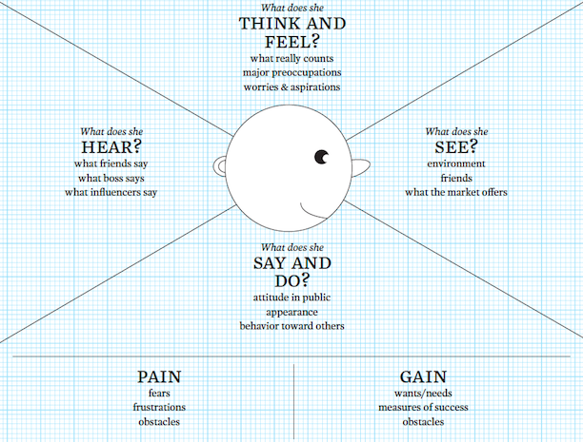
Customer Empathy Map

Slide 11
Value Proposition
What value do we deliver to the customer?
Which one of our customer’s problems are we helping to solve?
What bundles of products and services are we offering to each Customer Segment?
Which customer needs are we satisfying?

Slide 12
Characteristics of a good VP
Newness
Performance
Customization
“Getting the Job Done”
Design
Brand/Status
Price
Cost Reduction
Risk Reduction
Accessibility
Convenience/Usability

Slide 13
Value Proposition Canvas

Slide 14
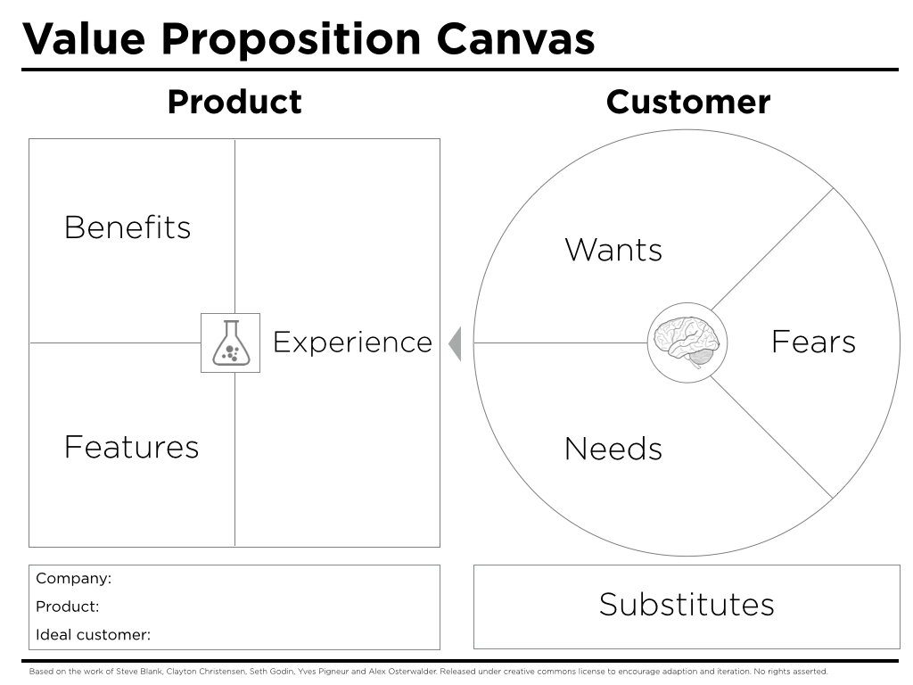

Slide 15
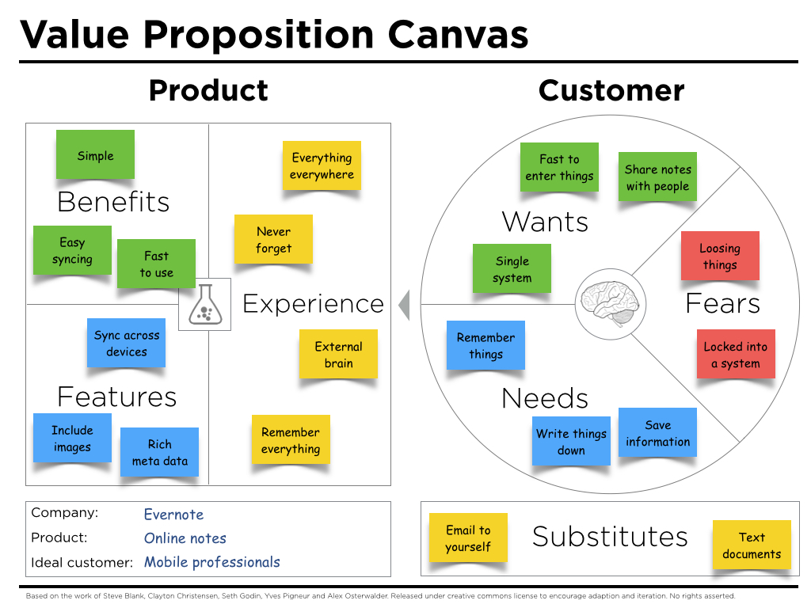

Slide 16
3. Channels
Through which Channels do our Customer Segments want to be reached?
How are we reaching them now?
How are our Channels integrated?
Which ones work best?
Which ones are most cost-efficient?
How are we integrating them with customer routines?

Slide 17
4. Customer Relationships
What type of relationship does each of our Customer Segments expect us to establish and maintain with them?
Which ones have we established?
How are they integrated with the rest of our business model?
How costly are they?

Slide 18
Examples of Customer Relationships
Personal assistance
Dedicated Personal Assistance
Self-Service
Automated Services
Communities
Co-creation
Same-side Network Effect
Cross-side Network Effect

Slide 19
Personal Assistance: Assistance in a form of employee-customer interaction. Such assistance is performed either during sales, after sales, and/or both.
Dedicated Personal Assistance: The most intimate and hands on personal assistance where a sales representative is assigned to handle all the needs and questions of a special set of clients.
Self Service: The type of relationship that translates from the indirect interaction between the company and the clients. Here, an organization provides the tools needed for the customers to serve themselves easily and effectively.

Slide 20
Automated Services: A system similar to self-service but more personalized as it has the ability to identify individual customers and his/her preferences. An example of this would be Amazon.com making book suggestion based on the characteristics of the previous book purchased.
Communities: Creating a community allows for a direct interaction among different clients and the company. The community platform produces a scenario where knowledge can be shared and problems are solved between different clients.
Co-creation: A personal relationship is created through the customer’s direct input in the final outcome of the company’s products/services.

Slide 21
5. Revenue Streams
For what value are our customers really willing to pay?
For what do they currently pay?
How are they currently paying?
How would they prefer to pay?
How much does each Revenue Stream contribute to overall revenues?

Slide 22
Types of Revenue Streams
Asset sale
Usage fee
Subscription Fees
Lending/Renting/Leasing
Licensing
Brokerage fees
Advertising
Freemium
Bait and Hook Model
Transaction Fee
Commission

Slide 23
6. Key Resources
What Key Resources do our Value Propositions require?
Our Distribution Channels?
Customer Relationships?
Revenue Streams?

Slide 24
Types of Key Resources
Physical
Intellectual (brand patents, copyrights, data)
Human
Financial

Slide 25
7. Key Activities
What Key Activities do our Value Propositions require?
Our Distribution Channels?
Customer Relationships?
Revenue streams?

Slide 26
8. Key Partners
Who are our Key Partners?
Who are our key suppliers?
Which Key Resources are we acquiring from partners?
Which Key Activities do partners perform?

Slide 27
8. Cost Structure
What are the most important costs inherent in our business model?
Which Key Resources are most expensive?
Which Key Activities are most expensive?

Slide 28
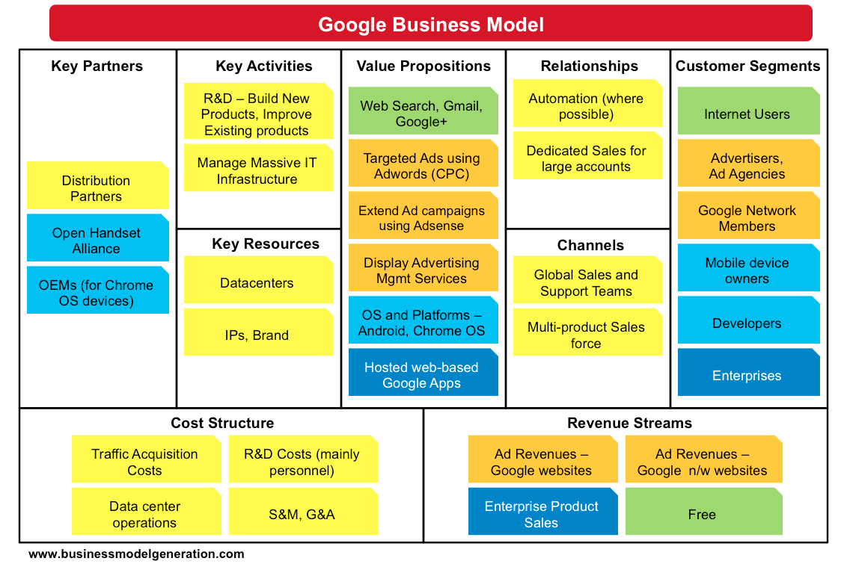

Slide 29
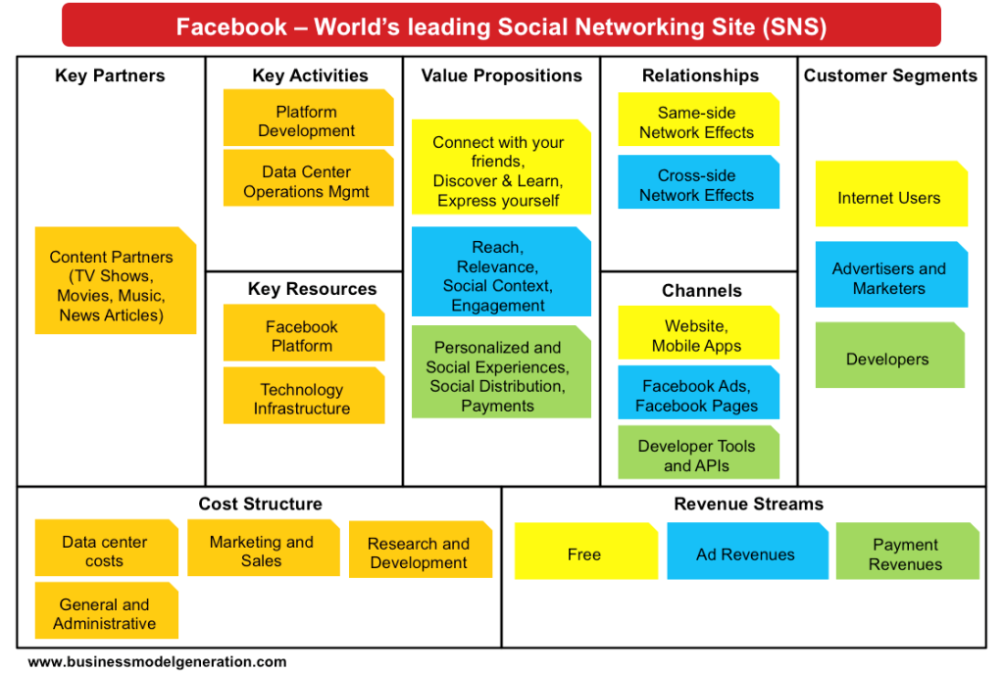

Slide 30
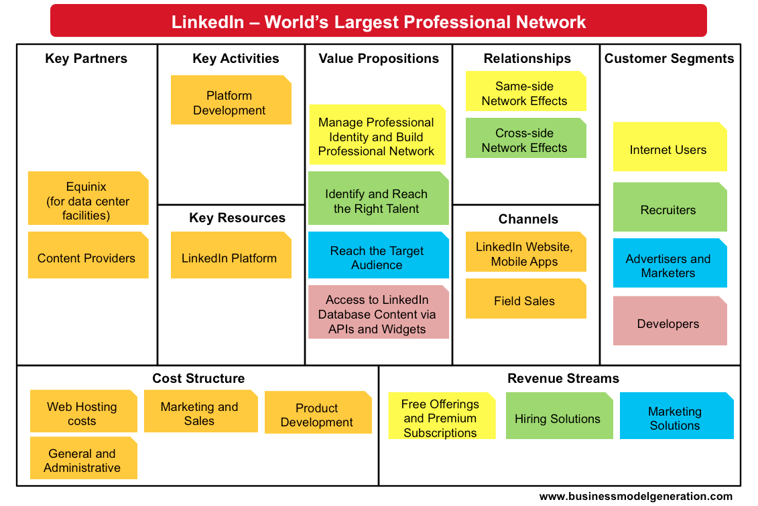

Slide 31
Business Model
#aidPH
15-November-2014
Iteration #2
Key Partners
Key Activities
Value Proposition
Customer Relationship
Customer Segments
OCD
Research & Development
PDRRMCs
Automated Services
Data Center Provides
System Maintenance
A Web and Mobile-based Information System for Philippine Disaster Risk Reduction and Management Councils
Govt. Agencies
Telecommunication Companies
Communities
Marketing & Promotion
LGUs
Key Resources
Channels
Tech Alliances
Tech. Infrastructure
#aidPH Website and Mobile App
NGOs
Advertisers
Financial
Partner Agencies & Programs
Public
Human Resources
Cost Structure
Revenue Streams
Administrative Operations & Planning
Marketing & Promote
Research & Development
Subscription Fee
Maintenance Fee
Premium
System Maintenance
Tech. Infrastructure
Server/Web Hosting Costs
Commission
Ad Revenue

Slide 32
Thank you.

